Slide 1
Great Day Fitness Tracking Information System
Name:
Course:
Instructor:
Date:

Slide 2
Information Systems Planning
  Business planning is the process of identifying the firm’s goals, objectives, priorities and developing action plans for accomplishing them.
  Information systems planning is the part of business planning concerned with developing the firm’s information systems resources (Peffers et al, 2007).
  Information systems planning should be an integral part of Great Day Fitness Tracking planning.

Slide 3
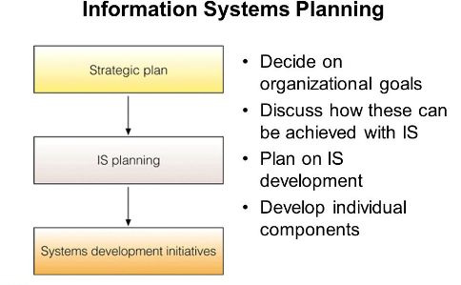
IS Planning Process
Source: Peffers et al, 2007.

Slide 4
Challenges in Business Planning
Foreseeing and assessing opportunities
Assuring consistency with organizational plans and objectives
Building systems
Maintaining information system performance
Collaborating with IT professionals

Slide 5
Principles of IS Planning
Support the firm’s business strategy with appropriate technical architecture
Evaluate technology as a component of a larger system
Recognize life cycle costs, not just acquisition costs.
Design information systems to be maintainable
Recognize the human side of technology use
Support and control the technical system

Slide 6
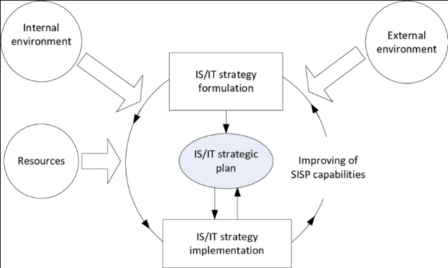
IS Strategic Planning
Source:

Slide 7
Information Systems Planning
To perform effective ISP, organizations conventionally apply one of several methodologies.
SISP presents many complex technical questions such as computer hardware, software, databases, and telecommunications technologies (Peffers et al, 2007).
As a result of this complexity, the computer experts work together with business planners for a better information system realization.

Slide 8
History
In late 1970s, information systems planning primary objectives were to improve communication between computer users or departments and increase top management support for computing.
Recently, two new objectives have emerged:
Identification of strategic information systems applications
Development of an organization-wide information architecture.
As new business ventures come up with new organization’s endeavours, new systems applications with new information architecture emerge (O'Leary, 2000).

Slide 9
methodologies
Carrying out SISP Organizations usually apply one of several methodologies to carry out this process.
Two popular ones are:
Business Systems Planning
PROplanner

Slide 10
Planning Process
An organization usually selects an existing methodology and then embarks on a major, intensive study.
The organization forms teams of business planners and computer users with IS specialists.
Using IS vendor’s educational support, the teams are trained and served with consulting support to guide and audit the study.
The team carries out a multi-step procedure study to identify the portfolio of applications needed.
It also defines databases, data elements, and a network of computers and communications equipment to support the applications and prepares a schedule for developing and installing them.

Slide 11
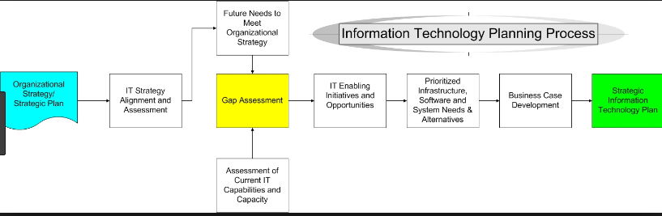
IS Planning Development
Source: Peffers et al, 2007.

Slide 12
Business Systems Planning (BSP)
It was developed by IBM, involves top-down planning with bottom-up implementation.
From the top-down, the study team first recognizes its firm’s business mission, objectives and functions, and how these determine the business processes.
It analyses the processes for their data needs.
From the bottom-up, it then identifies the data currently required to perform the processes.
BSP places heavy emphasis on top management commitment and involvement.

Slide 13
PROplanner
PROplanner, by Holland Systems Corp. in Ann Arbor, Michigan, helps planners analyse major functional areas within the organization.
They then define a Business Function Model.
They derive a Data Architecture from the Business Function Model by combining the organization’s information requirements into generic data entities and broad databases (McNurlin & Sprague, 2001).
They then identify an Information Systems Architecture of specific new applications and an implementation schedule.

Slide 14
Great Day Fitness Tracking Choice
The best choice for Great Day Fitness Tracking is PROplanner due to the following advantages
PROplanner offers automated storage, manipulation, and presentation of the data collected during IS planning and produces reports in various formats and levels of detail.
Affinity reports show the frequencies of accesses to data. Clustering reports guide database design.
Menus direct the planner through on-line data collection during the process.
A data dictionary (a computerized list of all data on the database) permits planners to share PROplanner data with an existing data dictionary or other automated design tools.

Slide 15
Summary
Information systems planners are not particularly satisfied with a single choice.
The best choice depends on the budget made, it requires extensive resources.
When the IS planning study is complete, further analysis may be required before the plan can be executed.
PROplanner offers a great deal – the potential to use information technology to realize current business strategies and to create new ones.
Despte its complex information technology ingredient, PROplanner is cheap and very similar to many other business planning endeavours.

Slide 16
References
McNurlin, B. C., & Sprague, R. H. (2001). Information systems management in practice. Prentice Hall PTR.
O'Leary, D. E. (2000). Enterprise resource planning systems: systems, life cycle, electronic commerce, and risk. Cambridge university press.
Peffers, K., Tuunanen, T., Rothenberger, M. A., & Chatterjee, S. (2007). A design science research methodology for information systems research. Journal of management information systems, 24(3), 45-77.

